Slide 1
Internet of things temperature readings – data analysis report
Created by Sukil Siva. S

Slide 2
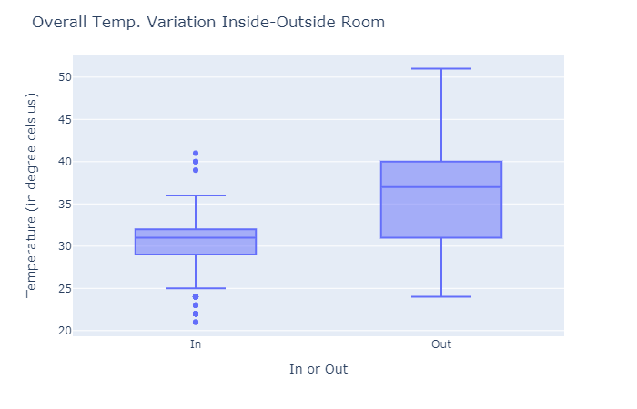
Temperature Inside and Outside Room

Slide 3
Overall Temp. Variation Inside-Outside Room In or Out Temperature (in degree Celsius) Observations: (assuming there are no outliers) Temperature recorded inside room : Min. temperature : 21°C. Max. temperature : 41°C. Temperature recorded outside room : Min. temperature : 24°C. Max. temperature : 51°C. Average temperature recorded inside the room < Average temperature recorded outside the room. This is an obvious thing to observe. Temperature has varied a lot outside room when compared to inside. Outside room : Magnitude of temperature variation before and after 37°C is almost same. However, temperature has varied a lot after reaching 40°C in comparison to temperature variation upto 31°C. How temperature varies across seasons? In [35]:
Summary of Inside/Outside Boxplot:

Slide 4
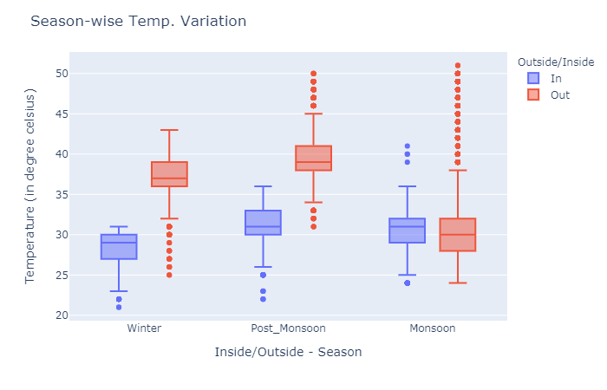
Season wise Temperature-Variation

Slide 5
Summary of Season-Wise Chart
Season-wise Temp. Variation Inside/Outside - Season Temperature (in degree celsius) Observations: (assuming there are no outliers)
Max. temperature of 51°C has been recorded in Monsoon season which is quite surprising and not expected in rainy season. Note: We have to yet see when was this temperature was recorded; Is it at the start of monsoon season or at the end of the season? As usual the lowest temperature of 21°C has been recorded in Winter season. Magnitude of temperature variation is observed inside room in Monsoon season is higher compared to Winter and Post Monsoon season. Similary, maximum temperature variation outside room is observed in Monsoon season. In comparison to average (median) tem

Slide 6
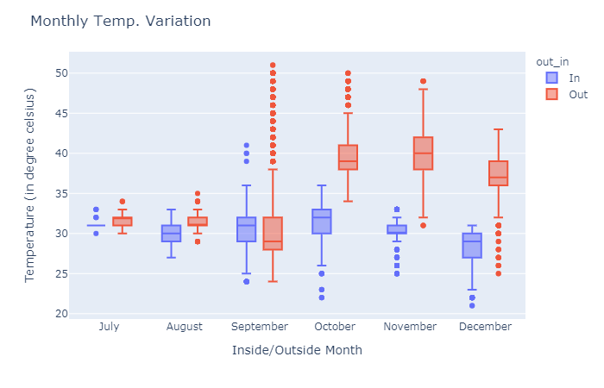
Month-Wise Temperature Variation

Slide 7
Summary of Month Wise Chart
Volume of data we have for July and August months is very very low compared to other months. Maximum temperature variations are observed in September month both inside and outside the room. Highest average temperature (median) of 39°C is observed in November months. Lowest temperature of 21°C is recorded in December month. Despite of Point No. 1, Minimum temperature variation is observed in July and August months. How temperature varies for different timings for all seasons?

Slide 8
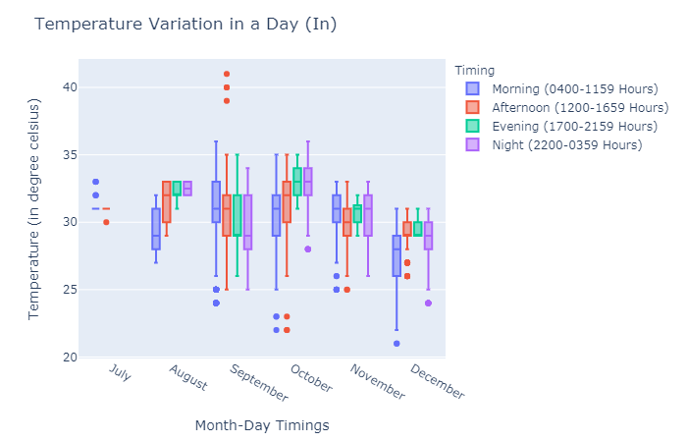
Temperature Variation in a Day

Slide 9
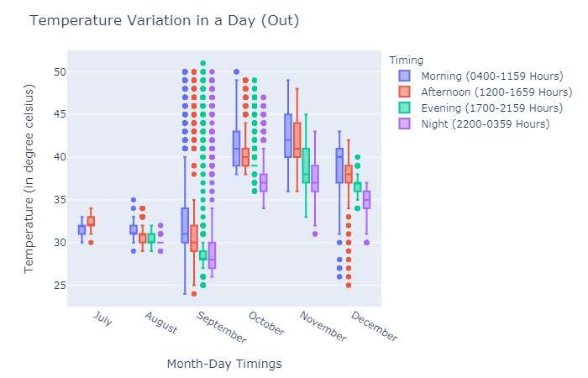
Day Chart Outside Room

Slide 10
Summary of Variation in Day Chart
Temperature Variation in a Day (Out) Month-Day Timings Temperature (in degree celsius) Observations: (assuming there are no outliers) (A) Inside room:
September month : Maximum temperature variation is observed in morning & evening. October month : Highest average (median) temperature of 33°C has been recorded during evening & night. Lowest temperature of 21°C is recorded in December month in the morning. Highest temperature of 41°C is recorded in September month in the afternoon between 1400-1500 hours. (B) Outside room:
September month : Maximum temperature variation is observed during afternoon. November month : Highest average (median) temperature of 42°C has been recorded in morning. Lowest temperature of 24°C is recorded in September month in the afternoon. Highest temperature of 51°C is recorded in September month in the evening between 1700-1800 hours.

Slide 11
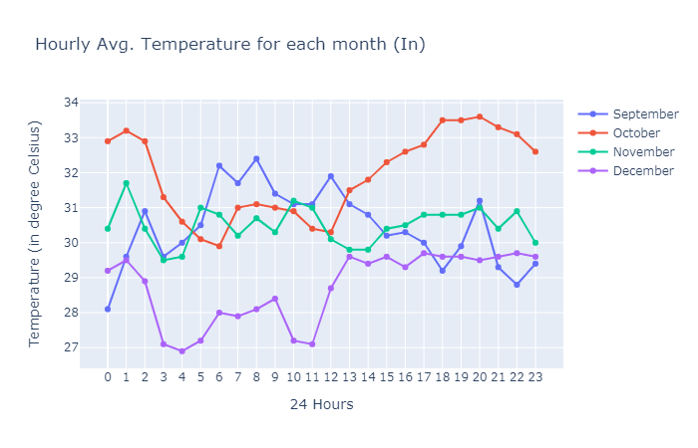
Hour Wise Temperature Chart (In)

Slide 12
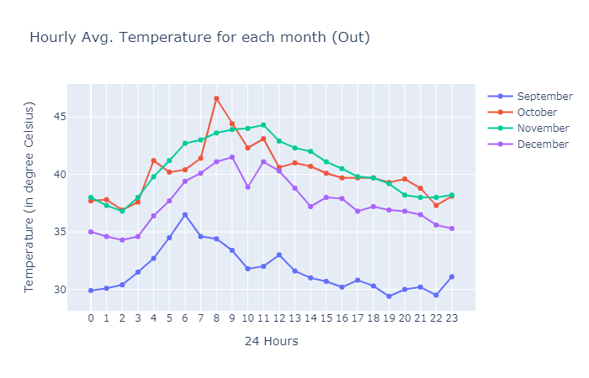
Hour Wise Temperature Chart (Out)

Slide 13
Summary of Hour Wise Chart
Temperature (in degree Celsius) Observations: (A) Inside room:
October month : Saw Highest Average (Median) temperature of 33.6°C between 2000:2059 hours. December month : Saw Lowest Average (Median) temperature of 26.9°C between 0400:0459 hours. (B) Outside room:
October month : Saw the Highest Average (Median) temperature of 46.6°C between 0800:0859 hours. December month : Saw the Lowest Average (Median) temperature of 29.4°C between 1900:1959 hours. Compared to September, October & November months, December month's average temperature per hour has always been on lower side.

Slide 14
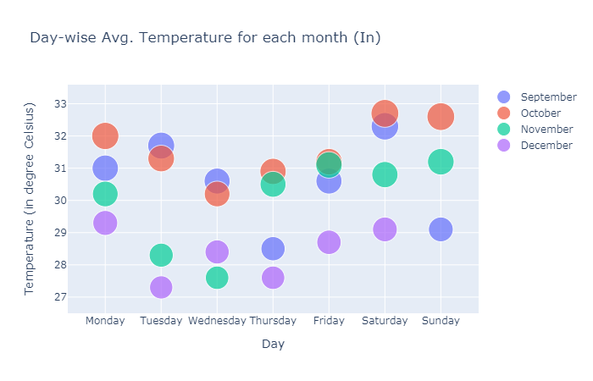
Day-Wise Average Temperature Each Month (In)

Slide 15
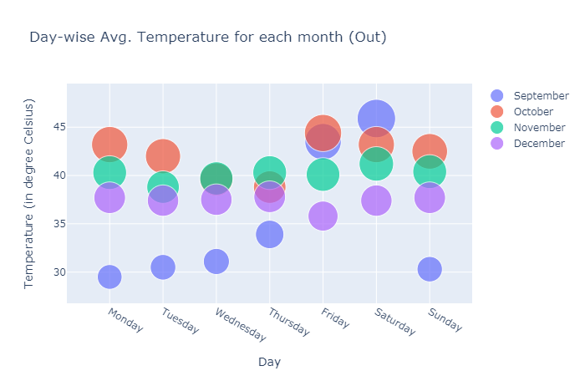
Day-Wise Average Temperature Each Month (out)

Slide 16
Summary of Report :
Based on Data we can find the temperature of IOT Devices and control electricity Measures
We used the plotly to plot different Graphs analysis

Slide 17
Thank You
Github Link :
https://github.com/sukilsiva/Machine-Learnig-Deep-Learning-Code/blob/master/Data%20Visualisations/Notebooks/IOT_Data_Vizualisation.py

